Slide 1
How MARRIAGE works
Lesson- 4

Slide 2
How MARRIAGE works
OBJECTIVES OF THE LESSON
To learn how to build a marriage relationship that cannot be shaken
To understand the wealth and purpose of children
To learn that your family will a witness of Christ to the community
DISCUSSION QUESTIONS AT END

Slide 3
How MARRIAGE works
KEY VERSE
The LORD God said, “It is not good for the man to be alone. I will make a helper suitable for him.”
Genesis 2:18

Slide 4
How MARRIAGE works
6 Reasons for Marriage
6. Walk in Service Together
4. Personal Enjoyment
5. Bear Witness of Christ
2. Mutual Support
1. Personal Companionship
3. Next Generation
God had a reason for creating marriage. The key verse says God realized Adam needed a companion, a helper. So, God created woman to help Adam and work with him.

Slide 5
How MARRIAGE works
Personal Companionship
In Genesis 1, God says six times that creation was “good.” Then in chapter 2 He says, “It is NOT good that the man should be alone.” God created Eve to be a friend and helper to Adam.

Slide 6
How MARRIAGE works
1. Personal Companionship
Mankind were created to be relational creatures. People need other people. They need companionship. They need supportive relationships. A person needs a relationship that will compliment them.

Slide 7
How MARRIAGE works
1. Personal Companionship
God intended that marriage partners become the primary source of companionship for each other throughout life. Each spouse is meant to meet their mate’s primary relational needs. Husbands and wives are meant to be best friends.

Slide 8
How MARRIAGE works
1. Personal Companionship
Numerous studies have been conducted to determine why some marriages are healthy and successful and others end in tragic divorce. The number one reason given by successful couples whose marriages have endured the difficulties of life is that they are best friends.

Slide 9
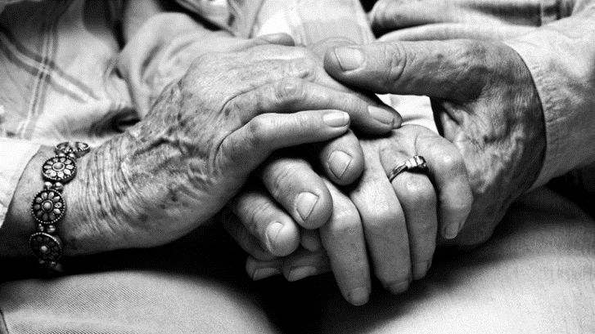
How MARRIAGE works
2. Mutual Support
Marriage does away with an unhealthy independent spirit and a sense of self-centeredness. God puts a man and woman together so they will have a constant support; someone always there to help, encourage, correct, and challenge them when the need arises. The pressures of life are lessened with the help of a God-given spouse.

Slide 10
How MARRIAGE works
2. Mutual Support
“So, they are no longer two, but one. Therefore, what God has joined together, let man not separate.” (Matthew 19:6)
The word “joined” is a word which literally means “yoked.” The image is of oxen paired together to complete a job with less effort by sharing the load.

Slide 11
How MARRIAGE works
2. Mutual Support
Every couple has a “load” to carry through life. When they are joined together in God, that load is shared by the other. The marriage relationship gives someone to lean on during the challenging seasons of life: stress, children, sickness, tragedy. The blessing of marriage is knowing there will always be someone there you can depend on.

Slide 12
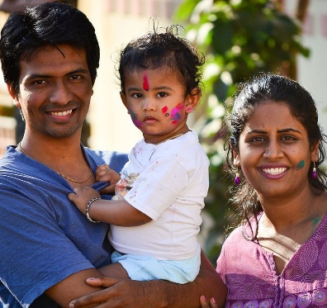
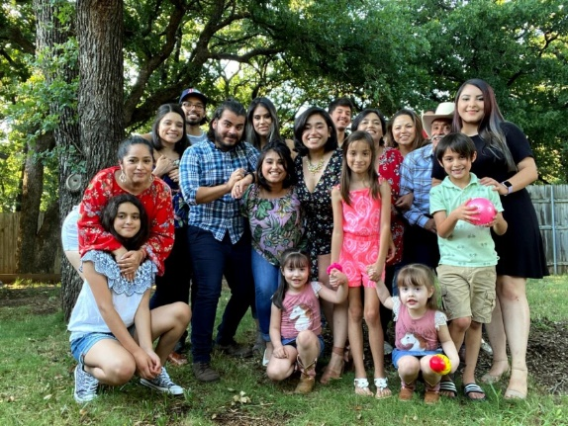
How MARRIAGE works
3. Next Generation
God blessed them and said to then, “Be fruitful and increase in number; fill the earth and subdue it. Rule over the fish of the sea and the birds of the air and over every living creature that moves on the ground.”
Genesis 1:28

Slide 13
How MARRIAGE works
3. Next Generation
One purpose for marriage is children. As those who love God, the couple has the privilege of leading their children to Christ. Parents are to establish the truth of God’s word into their children so they can grow to know God and become responsible godly adults. The Bible contains specific instructions for parents.

Slide 14
How MARRIAGE works
3. Next Generation
Instructions for parents concerning children
Fathers, do not exasperate your children; instead, bring them up in the training and instruction of the Lord. (Ephesians 6:4)
He decreed statutes for Jacob and established the law in Israel, which he commanded our forefathers to teach their children, so the next generation would know them even the children yet to be born and they in turn would tell their children. Then they would put their trust in the God and would not forget his deed but would keep his commands. (Psalm 78: 5-7)
These commandments that I give you today are to be on your hearts. Impress them on your children. Talk about them when you sit at home and when you walk along the road, when you lie down and when you get up. (Deuteronomy 6: 6-7)
Start children off on the way they should go, and even when they are old they will not turn from it. (Proverbs 22:6)

Slide 15
How MARRIAGE works
3. Next Generation
The family is intended to be a training ground for children to learn how to relate with other people. It also helps them make responsible decisions, be educated and learn about life from God’s point of view.

Slide 16
How MARRIAGE works
3. Next Generation
God wants relationship with children and intends for them to be brought into the world within the safety and protection of a home where a husband and wife can care for them.
It is not God’s perfect plan for children to be raised by only one parent, or none. Sometimes this is unavoidable, and God’s grace is able to help sustain the single parent, or orphaned child.
However, when both a husband and wife share the responsibilities of parenting, children feel the strength, love and support that God intended.

Slide 17
How MARRIAGE works
3. Next Generation
Children are God’s
future leaders who
will impact nations.

Slide 18
How MARRIAGE works
3. Next Generation
Sons are a heritage from the LORD, children a reward from him. (Psalm 127:3)
Every child is born with a divine destiny. They should not be treated as a burden or devalued. Children—both sons AND daughters—are to be valued as a nation’s greatest asset because they determine its future. It takes time, energy and money to raise children the way God instructs, but it is worth it for the benefit of society.

Slide 19
How MARRIAGE works
3. Next Generation
Couples should not refuse to have children for selfish reasons like personal freedom, wealth and independence. This is a violation of God’s heart.
If a couple is unable to have children for physical reasons, they may help guide children through teaching/volunteering, or may even become parents to orphaned children.
Every child deserves parents. Children are to be treasured and cherished. Having children is a fulfillment of God’s purpose for marriage.

Slide 20
How MARRIAGE works
4. Personal Enjoyment
God wants marriage, which is the deepest of all relationships, to produce enjoyment.

Slide 21
How MARRIAGE works
4. Personal Enjoyment
Enjoyment can be found in:
Spending time with one another
Developing interests together
Sexual intimacy (exclusively with one another)

Slide 22
How MARRIAGE works
4. Personal Enjoyment
May your fountain be blessed, and may you rejoice in the wife of your youth. A loving doe, a graceful deer—may her breasts satisfy you always, may you ever be captivated by her love. Why be captivated, my son, by an adulteress? Why embrace the bosom of another man’s wife? For a man’s way are in full view of the LORD, and he examines all his paths.
Proverbs 5:18-21

Slide 23
How MARRIAGE works
4. Personal Enjoyment
To get sexual fulfillment outside of the marriage is to walk in open rebellion and sin. It is a violation of the covenant.
As a husband and wife develop their friendship with each other, their sexual life together will be more satisfying as well. They do not have a desire to go anywhere else to find sexual fulfillment. True friendship between them becomes a strong safeguard for their marriage especially in the area of sexual purity.

Slide 24
How MARRIAGE works
5. Bear Witness of Christ
“…For this reason, a man will leave his father and mother and be united to his wife, and the two will become one flesh?” This a profound mystery—but I am talking about Christ and the church. However, each one of you also must love his wife as he loves himself, and the wife must respect her husband.
Ephesians 5:31-33

Slide 25
How MARRIAGE works
5. Bear Witness of Christ
In Ephesians 5 & 6, the apostle Paul addresses family roles and responsibilities.
The couple are to leave the authority of their parents and “cleave” to one another
“Cleave” means to cling closely, steadfastly and faithfully to someone or something
The couple are now a new family unit and are responsible to establish their home on God’s principles

Slide 26
How MARRIAGE works
How marriage is to be like Christ and the Church
1. Covenant—covenant is the basis for marriage (Matthew 19: 5-6, Genesis 2:24) and is also the basis for the Christian relationship (Hebrews 8:6-13, Matthew 26:28)
2. Headship—established the husband as the leader of the marriage and Jesus as the leader of the Church (Ephesians 5:23)
3. Love—love gives husbands the power to lead, and the love of God is what draws people to Him (Ephesians 5:25-28, 33)
4. Submission—the wife submits to her husband's authority out of respect and love and the Church submits to Christ’s authority out of respect and love (Ephesians 5:24)
5. One Body—in the same way, the Bible says that a married couple become one, Jesus said that believers are one body in Christ. In other words, there is a union that cannot be broken. (Ephesians 5:29-30)

Slide 27
How MARRIAGE works
5. Bear Witness of Christ
Therefore, when married couples teach their children how to love Christ, they should be able to point to their marriage as an example.
The marriages of pastors, church leaders, and mature Christians should also present a spiritual example to unbelievers and young believers of how the Church relates to Jesus.

Slide 28
How MARRIAGE works
6. Walk in Service Together
In Genesis 1: 27-28, God reveals another reason for marriage—to subdue the earth and rule over it.
They are called together, not separately.
Both are important, husband and wife.
Husbands, in the same way be considerate as you live with your wives and treat them with respect [honor] as the weaker partner and as heirs with you of the gracious gift of life, so that nothing will hinder your prayers. (1 Peter 3:7)

Slide 29
How MARRIAGE works
6. Walk in Service Together
Husbands are called to treat their wives with honor because they are equals in the family of God--both heirs of His grace. Both have a service to God that is valuable and necessary. Husbands should support their wives as they seek to fulfill God’s will for their lives.

Slide 30
How MARRIAGE works
6. Walk in Service Together
As seen in Acts 18:24-26, it is not the husband alone who helps in ministry, they are a team. It is important for couples to consider why God brought them together and what purpose they have together. They should not get jealous of one another but should serve with grace together. Many times, God puts couples together because of the service they are called to perform.

Slide 31
How MARRIAGE works
6. Walk in Service Together
It is easy for a couple to begin living separate lives in service to God. A husband may be involved as a pastor or teacher and a wife may be involved in service to the music. They spend a lot of time doing their service and forget to spend time with each other. Sometimes they even use their service as an excuse for not fulfilling their marriage responsibilities. Service to Christ should NEVER be a point of separation and should never violate the primary responsibility they have of being husband and wife.

Slide 32
How MARRIAGE works
6. Walk in Service Together
An unhealthy marriage can damage a believer’s witness to others. A healthy marriage must be maintained within service, so the message of Christ is not lost in the community. A loss of relationship with one another could result in a loss of service to Christ as well.

Slide 33
How MARRIAGE works
6. Walk in Service Together
What should a couple do if they find themselves in this situation?
They should work to resolve marital problems.
Read God’s word
Pray together
Discuss their commitment
Repent and ask forgiveness
Make a plan to correct issues and avoid them in the future

Slide 34
How MARRIAGE works
6. Walk in Service Together
Serving God together should be done with great consideration, balance and prayer. Ultimately, both the husband and wife are meant to serve God. The most fulfilling marriages are those that serve Christ together.

Slide 35
How MARRIAGE works
6. Walk in Service Together
The purposes God created marriage for…
To have a friend
To have help
To have children
To have fun
To have a witness
To have service to Christ

Slide 36
How MARRIAGE works
A Brief Summary
Knowing the reasons God has for marriage—companionship, support, children, enjoyment, witness, and service—will help a couple fill their marriage and life with good things. The treasures of these relationships will be experienced, and the peace of God will remain.

Slide 37
How MARRIAGE works
DISCUSSION
QUESTIONS

Slide 38
How MARRIAGE works
This lesson gives six purposes for marriage. Read the scriptures associated with each purpose and discuss why each one is important to a successful marriage.
Personal Companionship (Genesis 2:18)
Mutual Support (Genesis 2:18, Matthew 19:6)
Next Generation (Genesis 1:28, Ephesians 6:4, Psalm 78:5-7, Psalm 127:3)
Personal Enjoyment (Proverbs 5:18-21)
Bear Witness of Christ (Ephesians 5:22-23)
Walk in Service Together (Genesis 1:27-28, 1 Peter 3:7, Acts 18:24-26)

Slide 39
How MARRIAGE works
Read Ephesians 5:22-23 and review section 5. Discuss how marriage can reflect to others the relationship Jesus has with His bride, the Church? Consider the following ideas relating to these relationships as stated in Scripture:
Covenant (Matthew 19:5-6, 26:28, Genesis 2:24, Hebrews 8:6-13)
Headship (Ephesians 5:23)
Love (Ephesians 5:25-28, 33)
Submission (Ephesians 5:24)
One Body (Ephesians 5:29-30

Slide 40
How MARRIAGE works
APPLICATION
If you are married, which of the six purposes of marriage is most evident in your marriage? Which is most lacking? Discuss these answers with your spouse. Write your thoughts. Together, pray and ask Jesus for help to make your marriage strong.
Read Ephesians 5 and 6. If you are married, read it together with your spouse. Identify and list family roles and responsibilities. Prayerfully consider areas in your marriage that need to improve or change. Write your thoughts. Keep your notes as these responsibilities will be discussed in Lesson 5 and 6.

Slide 41
How MARRIAGE works
Contact: Info@Equippersgroup.org

