Slide 1
satan & temptation
Lesson- 6

Slide 2
satan & temptation
OBJECTIVES OF THE LESSON
To understand Satan is real, at war with God and a liar
2. To understand that Jesus defeated Satan
To know that you have victory over Satan through Jesus
Identify Satan’s lies that have affected you
DISCUSSION QUESTIONS AT END

Slide 3
satan & temptation
KEY VERSES
He who does what is sinful is of the devil, because the devil has been sinning from the beginning. The reason the Son of God appeared was to destroy the devil’s work.
1 John 3:8

Slide 4
satan & temptation
Who is Satan?
Satan is a powerful angel created by God to worship and serve Him continually. However, he chose to rebel from that purpose and became God’s enemy. Satan’s presence is real in Bible times AND now. At least seven Old Testament and all of the New Testament books refer to Satan. The good news is that Christians have power over Satan through Jesus’ death and resurrection.
Satan was perfect, wise, beautiful and anointed as a guardian angel. He is also described as blameless until wickedness found him. Satan wanted to ascend into heaven, exalt his throne above God, be like Most High God. This was the sin of pride.
Read Ezekiel 28:11-19, Isaiah 14:12-20 and Revelation 20:1-10

Slide 5
satan & temptation
Who is Satan?
Satan is a liar and deceiver. He is known by many titles and names that describe his attributes. He is our enemy and active in the world today. His names provide a picture of his evil character and works.
Titles of Satan:
Satan (adversary)—Matt. 4:10
The Devil (slanderer)—Matt. 4:1
Beelzebub (dung-god)—Matt. 12:24
Belial (worthlessness)—2 Cor. 6:15
Names of Satan:
Morning Star (Lucifer)—Isa. 14:12
Evil One—Matt. 13:19, 1 Jn. 5:19
The tempter—Matt. 4:3, 1 Thes. 3:5
The prince of this world—Jn. 12:31, 14:30, 16:11
The god of this age—2 Cor. 4:4
The ruler of the kingdom of the air—Eph. 2:2
The accuser of our brothers—Rev. 12:10
The prince of demons—Matt. 12:24
Descriptions of Satan:
Serpent—Gen. 3:4, Rev. 12:9
Dragon—Rev. 12:3-4
Angel of light—2 Cor. 11:14
Roaring lion—1 Pet. 5:8

Slide 6
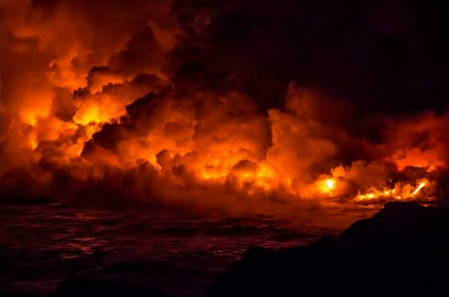
satan & temptation
Characteristics of Satan
Satan masquerades throughout the world today in many disguises. There are many more Scriptures about Satan, look for them as you study the Word of God. His most common character traits are listed below.
Schemer
Slanderer & Accuser
Tempter
2 Cor. 2:11
Rev. 12:10
Matt. 4:1
Liar & Murderer
Deceiver
Oppressor
Hinderer
John 8:44
Rev. 12:9
Acts 10:38
1 Thes. 2:18

Slide 7
satan & temptation
Satan’s mission
Satan is constantly trying to destroy God’s purpose and plan. He wants to hurt God by attacking mankind, especially the believers. His evil ambition has always been the same—to usurp God’s throne and turn man away from God.
Satan attempts to destroy God’s plan
In relation to Jesus and God’s plan to save mankind
 | Conflict (Gen. 3:15) | Destroy the work of Jesus (Matt. 16:23, Jn. 8:43-44
 | Temptation of Jesus (Matt. 4:1-11) | Possessed Judas to betray Jesus (Jn. 13:27)
In relation to the nations
 | He deceives them now (Rev. 12:9) | He will gather them to the battle of Armageddon (Rev. 16:13-14)
In relation to unbelievers
 | Blinds their minds (2 Cor. 4:4) | Snatches the Word from their hearts (Lk. 8:12)
In relation to the Christians
 | He tempts them to lie (Acts 5:3) | He tempts believers to be immoral (1 Cor. 7:5)
 | He accuses and slanders them (Rev. 12:10) | He sends false teachers into the church (2 Cor. 11:13-15, Matt. 13: 38-39)
 | He hinders their work (1 Thes. 2:18) | He causes persecutions against them (Rev. 2:19)
 | He uses evil forces to tempt them (Eph. 6:11-12)

Slide 8
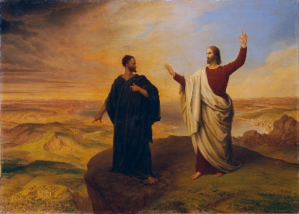
satan & temptation
Examples of Satan’s temptations
Satan will use all of his tricks to turn man away from God. Read Genesis 3 again, paying close attention to Satan’s part in Adam and Eve’s sin. Satan is a schemer, liar and deceiver while presenting himself as the serpent.
The first temptation—Adam & Eve
God created the first people to rule over and care for the earth. They were free to eat of any tree, save one. The “tree of the knowledge of good and evil” was off limits. God gave man the choice to obey and follow God or to sin and follow our own ways. (Gen. 2:15-17)
Satan deceived Eve by lying to her. He told her God would not punish her like he said and that she would become like God herself. (Gen. 3:4-5)
She believed the lie and ate the fruit and gave it to Adam as well. (Gen. 3:6)
This was the first sin. Since this time all mankind has been ruled by a sinful nature.
Temptation of Christ
Scripture says Jesus was tempted by Satan in three areas—lust of the flesh, lust of the eyes, and pride of life. Jesus did not give in. We are to follow His example in defeating Satan by speaking and praying the Word of God in response to temptation and live guided by the Holy Spirit.
(Matt. 4:1-11, Mk. 1:12-13, Lk. 4:1-13, Heb. 4:15)
Comparison of responses by Eve and Jesus
1 John 2:16 | Eve (Gen. 3:6) | Jesus (Lk. 4:1-13)
Lust of the flesh | Good for food | Stones become bread
Lust of the eyes | Pleasing to the eye | Showed kingdoms of the world
Pride of life | Desirable for gaining wisdom | Throw himself and command angels to save him

Slide 9
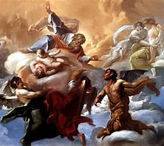
satan & temptation
How powerful is Satan?
God is in control—Satan is defeated!
God and Satan are NOT equals. God is the ruler over all—including Satan. Then why does God allow evil? This question has been debated for centuries. Scripture reveals that Satan does not have complete freedom to inflict his evil on the world or on God’s people. Everything that happens to God’s people is filtered through His loving hands (Rom. 8:28).
No temptation has seized you except what is common to man. And God is faithful; he will not let you be tempted beyond what you can bear. But when you are tempted, he will also provide a way out so that you can stand up under it. (1 Cor. 10:13)
Here are some examples of God limiting Satan’s ability to cause trouble for the believer:
In the life of Job (Job. 1:7-2:7)
In the life of Peter (Luke 22:31)
In the life of the church (Matt. 16:17-18)

Slide 10
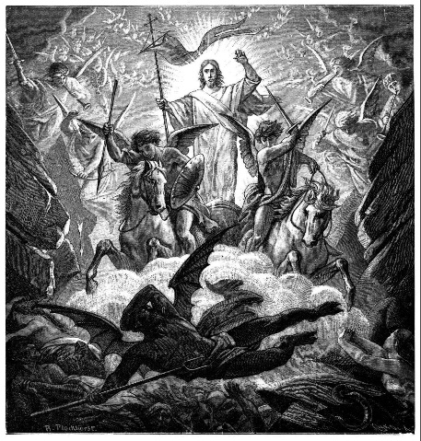
Nature of mankind
Satan defeated by Jesus
Satan was defeated by the death and resurrection of Jesus. He only seems strong when people believe his lies. When a Christian experiences the cleansing power of Jesus’ death and resurrection, the devil’s power is neutralized—he is no longer in control. A new power is placed within the Christian—the Holy Spirit. We are instructed to walk in obedience to His promptings each day. (Jn. 12:30-31, Rom. 6:8-14, 2 Thes. 2:8, Heb. 2:14, 1 Jn. 3:8-10)
It is also important to understand Satan’s tactics, so we are not outwitted by him. Satan still comes to tempt Christians to sin; however, through Jesus they are delivered from the results and power of the sin. (Rom. 6:10-12)
We know from Jesus’ example that the Word of God is a weapon against Satan. We also have the Holy Spirit to lead us in a God pleasing life. (Eph. 6:10-18)

Slide 11
Nature of mankind
What is Satan’s end?
The books of Ezekiel and Revelation tell about the end of Satan and demons. Satan has been punished in part by being driven out of heaven in disgrace. Eventually he will be eternally punished in hell, forever separated from God.
And the angels who did not keep their positions of authority but abandoned their own home—these he has kept in darkness, bound with everlasting chains for judgement on the great Day. (Jude 6)
And the devil, who deceived them, was thrown into the lake of burning sulfur, where the beast and the false prophet had been thrown. They will be tormented day and night for ever and ever. (Rev. 20:10)

Slide 12
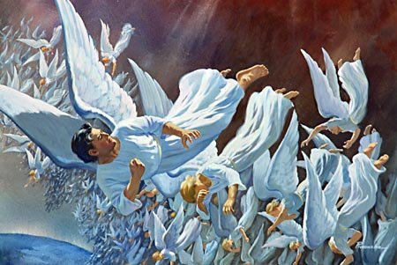
satan & temptation
What are demons?
Demons are angels created by God who followed Satan when he rebelled. As their leader, Satan is the prince of all demons, and organizes them into an army to oppose God and His people. Scripture shows that demons are active in many areas.
Their primary purpose is to destroy the purpose of God. (Dan. 10:10-14, Rom. 8:38-39, Rev. 16:13-16) | They can possess animals (Mk. 5:13)
They can inflict disease (Matt. 9:33, Lk. 13:11-16) | They oppose spiritual growth of God’s children (Eph. 6:12)
They can possess men (Matt. 4:24) | They teach false doctrine (1 Tim. 4:1)
Through the Holy Spirit and the Word of God, believers have authority (or control) over demons. (Matt. 25:41, 2 Pet. 2:4, Jude 6 and 9)

Slide 13
Nature of mankind
Recognizing Satan’s lies
Satan attacks the individual Christian mostly through deception and temptation. We must remember that sin has consequences.
Do not be deceived: God cannot be mocked. A man reaps what he sows. The one who sows to please his sinful nature, from that nature will reap destruction; the one who sows to please the Spirit, from the Spirit will reap eternal life.
(Gal. 6:7-8)
Satan tells us the lie that to be happy and secure we need more “stuff” in this world. His lies appeal to the lust of the flesh, lust of the eyes and pride of life.

Slide 14
Nature of mankind
Satan’s lies vs. God’s Truth
Lie: to be happy and secure I need things
Truth: Everything I need is found in Christ
Keep your lives free from the love of money and be content with what you have, because God has said, “Never will I leave you; never will I forsake you.”
(Heb. 13:5)
Mk. 8:1-8, 8:36, Phil. 3:7-8, 4:11-13, Col. 3:2
Lie: I need approval of others (fame, honor, recognition)
Truth: It is only God’s approval and acceptance I need
Am I now trying to win the approval of men, or of God? Or am I trying to please men? If I were still trying to please men, I would not be a servant of Christ.
(Gal. 1:10)
1 Cor. 11:19, 1 Thes. 2:4
Lie: I need to have control of everything in my environment
Truth: I need to be controlled by the Spirit
The mind of a sinful man is death, but he mind controlled by the Spirit is life and peace. (Rom. 8:6)
Matt. 20:26-28, Mk. 8:35, 10:43-44, Phil. 2:3-11

Slide 15
Nature of mankind
Satan’s lies vs. God’s Truth
Lie: I need pleasures of the flesh (sex, gluttony, intoxication)
Truth: I must control my body in the Spirit for the greater good.
You have made known to me the path of life; you will fill me with joy in your presence, with eternal pleasures at your right hand. (Ps. 16:11)
Pr. 21;17, Ecc. 2:1-11, Rom. 12:2, 1 Cor. 9:27, 2 Tim. 3:2-4,
Tit. 2:11-12, Heb. 11:25
Lie: I need to have worldly knowledge
Truth: I need knowledge and thoughts obedient to Jesus
See to it that no one takes you captive through hollow and deceptive philosophy, which depends on human tradition and the basic principles of this world rather than on Christ. (Col. 2:8)
Rom. 12:2, 2 Cor. 10:4-5, Col. 1:9, 2:2-3, 1 Tim. 6:20

Slide 16
satan & temptation
DISCUSSION
QUESTIONS

Slide 17
satan & temptation
Who is Satan and who created him?
Why does man have a natural tendency to sin?
How can we have victory over the temptation of Satan?

Slide 18
satan & temptation
APPLICATION
Memorize 1 John 3:8
Be ready to share an experience where you were able to overcome temptation.
What other lies has the Holy Spirit revealed to you where Satan has been tempting you? Write them down and pray for strength to overcome these temptations.

Slide 19
satan & temptation
Contact: Info@Equippersgroup.org

